Slide 1

Topic: Statistics Investigation EQ: What is the Problem that I need to solve and what mathematics can I use to solve the Problem?
Year 7 Mathematics
Mrs Parlevliet

Slide 2
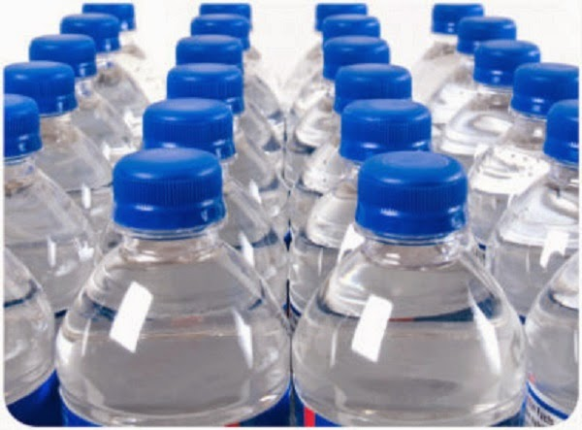
Quickwrite
Bottled Water vs Tap Water
Which one is better?
Notes:
Students need to be sitting in their groups.
Give students 1 minute to work in a group to write down as many possible answers to the question.
Run a whole class discussion to collect responses

Slide 3
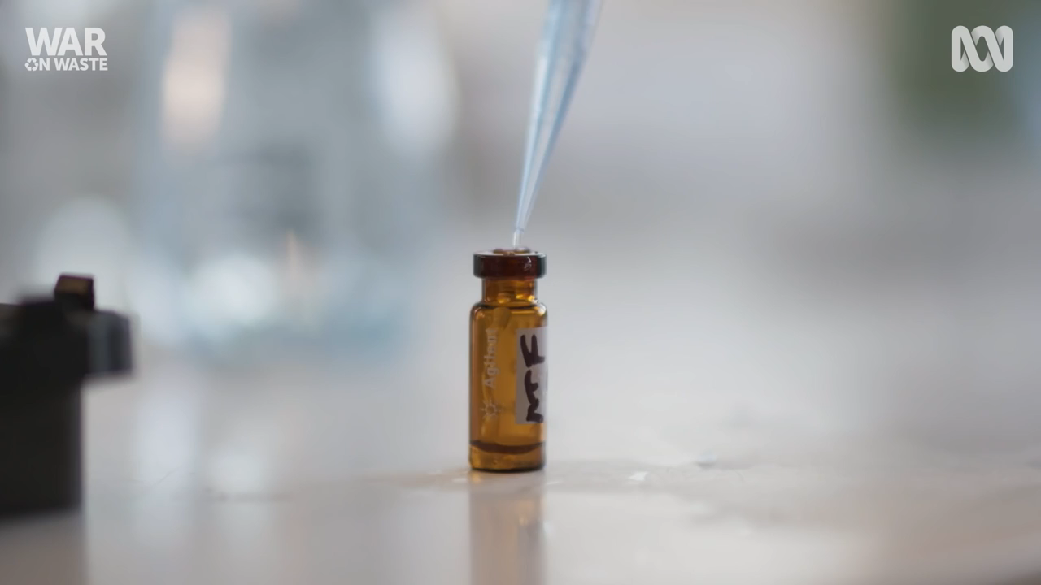
Bottled WATER VS TAP WATER
https://www.youtube.com/watch?v=X5zJQtBLJqI
Notes:
Play video.
Compare the information with what was in the video with the answers to the question posed at the beginning of the lesson.

Slide 4
24
7
30
Topic: Statistics
Date: XX/XX/2021
EQ: What is the Problem that I need to solve and what mathematics can I use to solve the Problem?
What part of the Mathematical Thinking Process do I use to solve a problem?
The two steps of the Mathematical Thinking Process that can help me identify the problem to solve and how to solve the problem are:
Check that your solution makes sense and provides answers to the problem.
Is your solution valid?
Does your solution answer the question?
Communicate your findings clearly.
Information is presented on the poster
Clear headings used
Was your method the best way of solving the problem? If you don’t think it is, explain how things could be improved for next time or things you would have like to have done if you had more time.
Diagrams, pictures, graphs are labelled or have captions
Poster requirements met, (Use the checklist to check this)

Slide 5
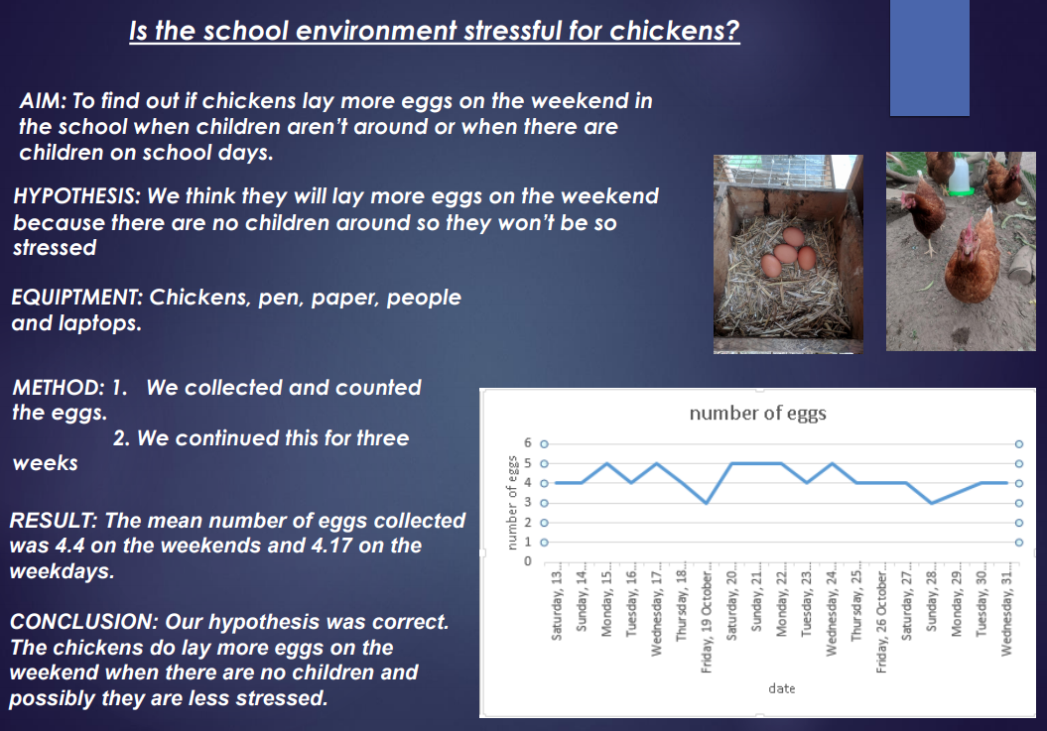
What Makes a Good Poster?
Working Collaboratively
Notes:
What went well?
Clear titles
Headings
Labelled graph
Relevant images/photos
Even Better If
Method had more detail
Working out of mean included
Conclusion included calculated values to support statements
References could be included

Slide 6
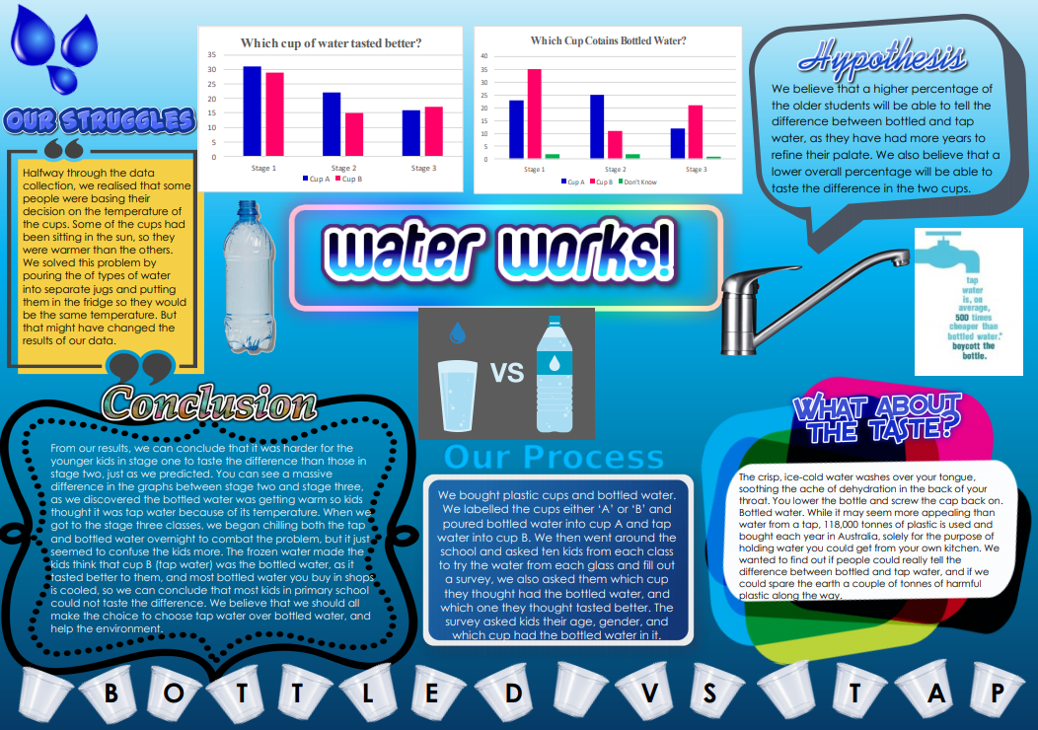
What Makes a Good Poster?
Working Collaboratively
Notes:
What went well?
Clear title
Headings used
Labelled graphs
Relevant images/photos
Eye catching
Even Better If
Method steps were numbered
Conclusion included calculated values to support statements
References could be included

Slide 7
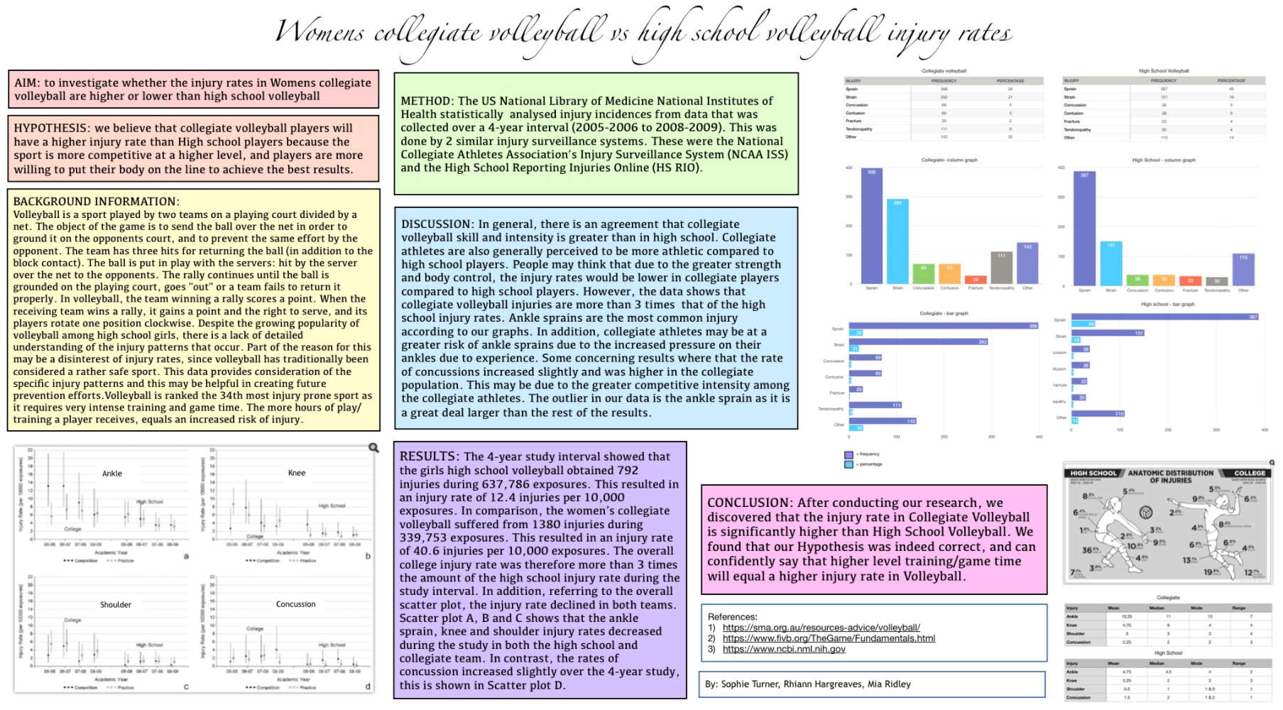
What Makes a Good Poster?
Working Collaboratively
Notes:
What went well?
Clear title
Headings used
Labelled graphs
Relevant images/photos
Eye catching
Even Better If
Method steps were numbered
Conclusion included calculated values to support statements

Slide 8
How Far does Water Travel?
Working Collaboratively
Notes:
How will you record the survey results?
How will you display the mathematical information?
Statistical analysis – mean, mode, range
Tables of data
Graphing
Showing working out
Writing your answer in words using your calculated values as evidence to back up your statements.

Slide 9
In Your Groups
Complete Step 5 and Step 6 before the end of the lesson.
Everyone needs to have contributed to the poster.
We are presenting the final posters next lesson in a Gallery Walk

